Slide 1
Introduction to Quantum Algorithms
CS.49900 (Spring 2026)
Reversible computing (+ complexity theory)

Slide 2
Administration
Midterm: April 23, 13:30 – 15:30 (or shorter?)
Final: June 18, 13:30 – 15:30
Presentation
20~30 min in the class
Anything that is not covered by the lecture
Error correction or fault-tolerant quantum computing/Quantum key distribution/Some advanced quantum algorithms/Any other advanced thing
You can choose (before presentation): +2%p in the score or replace two Psets
Syllabus will be updated in this weekend (or not?)

Slide 3
Survey statistics
Most of you know linear algebra
Most of you claim to know polynomial time algorithm … but many say do not know complexity well
Most of you can use LaTeX!
Interest by score (total=21):
Some comments mention “basics” while some mention “advanced”
Other comments say “please give good grades (?)”
Advanced algo/applications | Advanced limitations of algo | Advanced complexity | Quantum cryptography | Recent experiments
17 | 15 | 11 | 16.5 | 11.5

Slide 4
Slide guide
Some contents are marked:
It may not be hard (require constant minutes), but I do not explain any detail
Some contents are marked:
It may need another lecture to fill the detail.
We always cover the main contents first.
If we have time at the end, I will explain something more advanced
Marked “slightly advanced” can be included in the test but not “advanced”
Slightly advanced
advanced

Slide 5
Today we will learn
Reversible computing
Why does it matter
What does it mean
Notations
Circuit-style description
Linear algebra description
Why does it matter?
This is a “simpler” version of quantum computing
To learn some notations (which will be used in quantum computing)

Slide 6
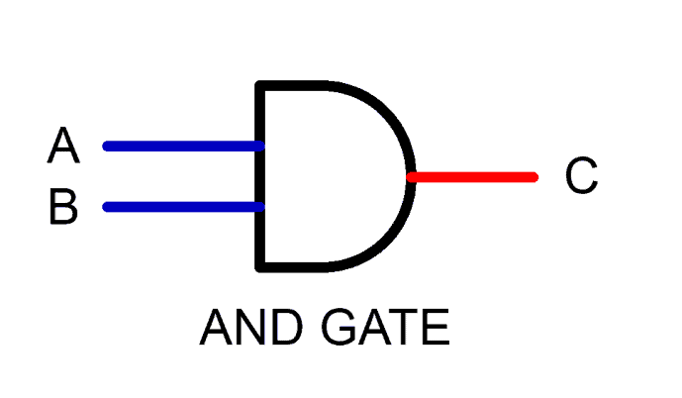
Physics of information
In (classical) computing, we see operations like
Information appears to be erased.
Is this actually possible? Can information… disappear?
...
A = 0 #reset
...
Notes:
To answer this, we really have to dig into the physics of how information is processed. Think about how information is stored on your hard drive, say. Ok, hard drives aren’t made like this anymore, but at some point they were stacks of discs and the data is stored via the orientation of magnetic material on disks. If the magnetization is pointing up, or down, that corresponds to 0 or 1. So when you erase or reset some information,

Slide 7
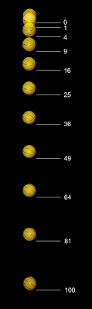
Reversibility of physics
The laws of physics are inherently reversible.
Any isolated physical process running in one direction, can (in principle) run in reverse.
In fact: at a microscopic level, one should not be able to tell the difference between time running forwards or backwards.

Slide 8
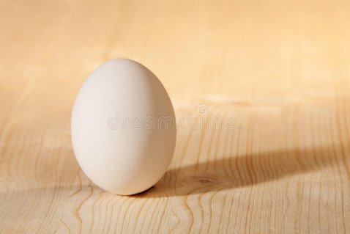
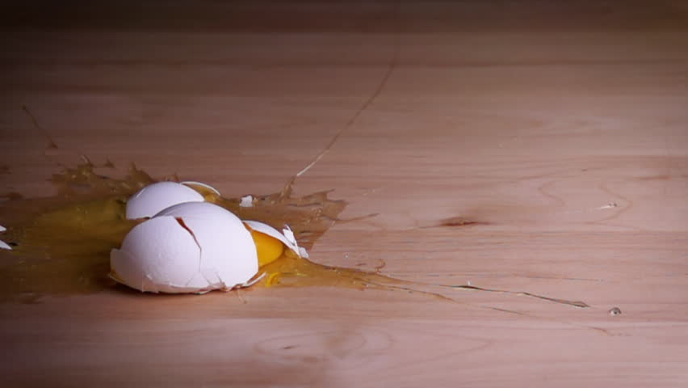
Reversibility of physics
Even the process of an egg falling and breaking is (in principle) reversible and possible according to physics.
However, in the macroscopic world such events are extremely unlikely.

Slide 9
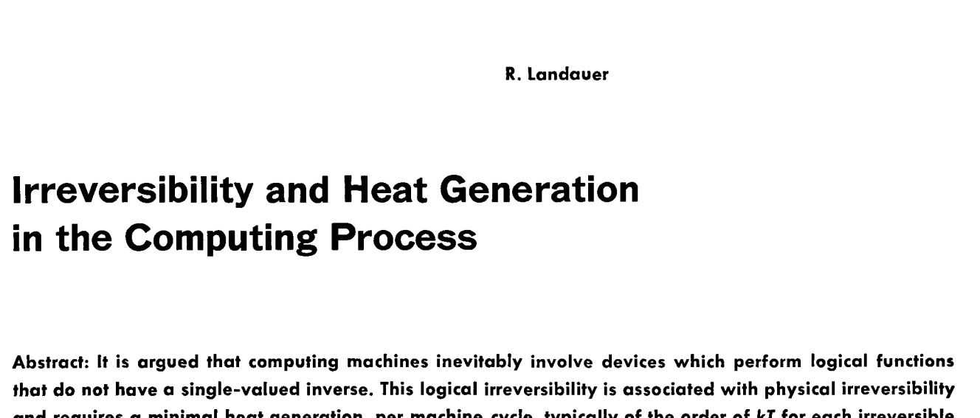
Reversibility of computation
In 1960s, a physicist Landauer had a simple but powerful observation:
Computation is a physical process.
Physical processes are fundamentally reversible.
Therefore, computation can be performed reversibly.
This observation led to study of reversible computing, which later influenced the study of quantum computing.

Slide 10


Reversible classical information processing
Consider a physical system $S$with d distinguishable states $\left|0\right\rangle ,…,|d−1⟩$
The information of the system is stored in its state.
We call it “ket”
$$S$$

Slide 11

Reversible classical information processing
Consider a physical system $S$with d distinguishable states $\left|0\right\rangle ,…,|d−1⟩$
The information of the system is stored in its state.
We call it “ket”
$$|0⟩$$
$$S$$

Slide 12

Reversible classical information processing
Consider a physical system $S$with d distinguishable states $\left|0\right\rangle ,…,|d−1⟩$
The information of the system is stored in its state.
We call it “ket”
$$|5⟩$$
$$S$$

Slide 13
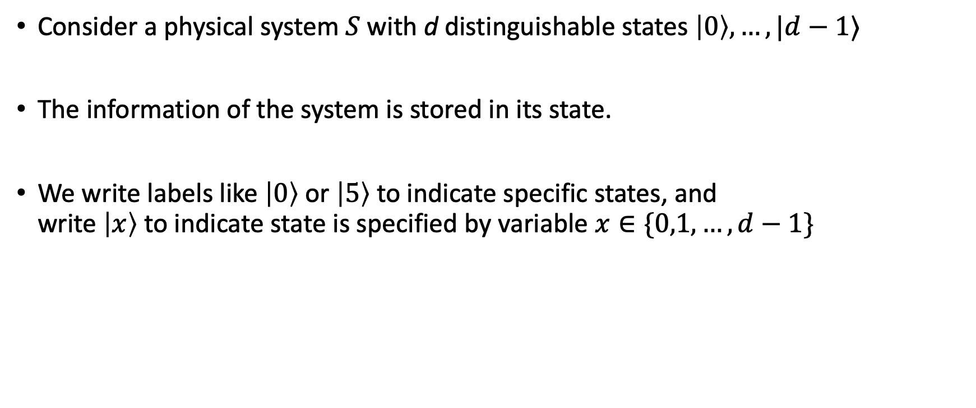

Reversible classical information processing
Consider a physical system $S$with d distinguishable states $\left|0\right\rangle ,…,|d−1⟩$
The information of the system is stored in its state.
We write labels like $\left|0\right\rangle$ or $\left|5\right\rangle$ to indicate specific states, and write $\left|x\right\rangle$ to indicate state is specified by variable $x∈\{0,1,…,d−1\}$
We call it “ket”
$$|x⟩$$
$$S$$

Slide 14


Reversible classical information processing
The system $S$can undergo transformations, which can change the state.
$$|x⟩$$
$$S$$

Slide 15


Reversible classical information processing
The system $S$can undergo transformations, which can change the state.
$$R$$
$$|y⟩$$
$$|x⟩$$
$$S$$

Slide 16
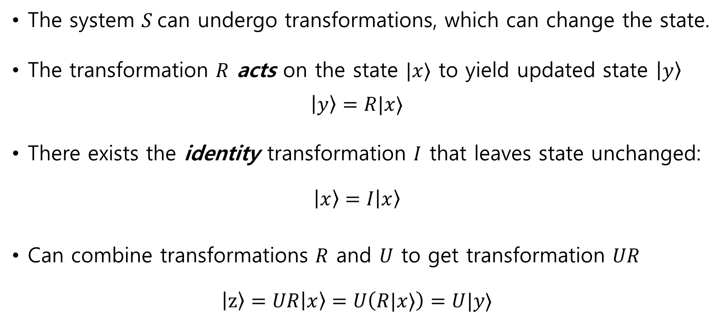

Reversible classical information processing
The system $S$can undergo transformations, which can change the state.
The transformation $R$ acts on the state $|x⟩$ to yield updated state $\left|y\right\rangle$ $\left|y\right\rangle =R|x⟩$
There exists the identity transformation $I$ that leaves state unchanged: $\left|x\right\rangle =I\left|x\right\rangle$
Can combine transformations $R$ and $U$ to get transformation $UR$ $\left|z\right\rangle =UR\left|x\right\rangle =U\left(R|x⟩\right)=U|y⟩$
$$|y⟩$$
$$S$$

Slide 17

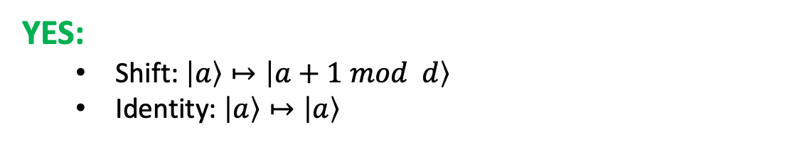

Reversible classical information processing
All transformations $R$must be reversible.
Equivalently: $R$ is a bijection between $\{0,1,…,d−1\}$
Equivalently: $R$ is a permutation
Equivalently: there exists inverse $R^{−1}$ so that $R^{−1}R=RR^{−1}=I$: $\left|x\right\rangle =R^{−1}R\left|x\right\rangle =RR^{−1}|x⟩$
NO:
$$\left|0\right\rangle ↦\left|0\right\rangle$$
$$\left|1\right\rangle ↦\left|0\right\rangle$$
YES:
Shift: $\left|a\right\rangle ↦\left|a+1 mod d\right\rangle$
Identity: $\left|a\right\rangle ↦\left|a\right\rangle$
$$|y⟩$$
$$S$$

Slide 18
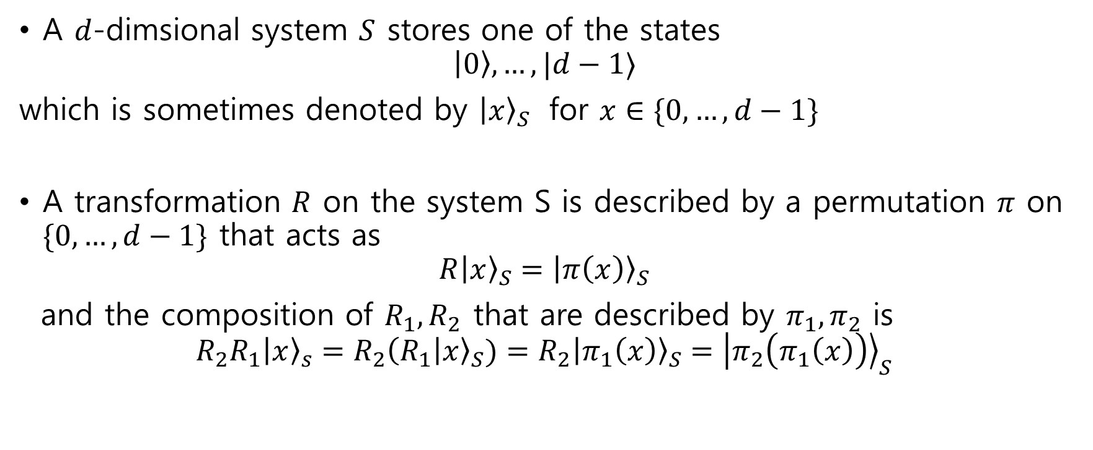
Summary for the single system
A $d$-dimsional system $S$ stores one of the states
$$\left|0\right\rangle ,…,|d−1⟩$$
which is sometimes denoted by ${\left|x\right\rangle }_{S}$ for $x∈\{0,…,d−1\}$
A transformation $R$ on the system S is described by a permutation $π$ on $\{0,…,d−1\}$ that acts as
$${R\left|x\right\rangle }_{S}={\left|π\left(x\right)\right\rangle }_{S}$$
and the composition of $R_{1},R_{2}$ that are described by $π_{1},π_{2}$ is
$$R_{2}R_{1}{\left|x\right\rangle }_{s}=R_{2}{\left(R_{1} | x\right\rangle }_{S})=R_{2}{\left|π_{1}\left(x\right)\right\rangle }_{S}={\left|π_{2}\left(π_{1}\left(x\right)\right)\right\rangle }_{S}$$

Slide 19

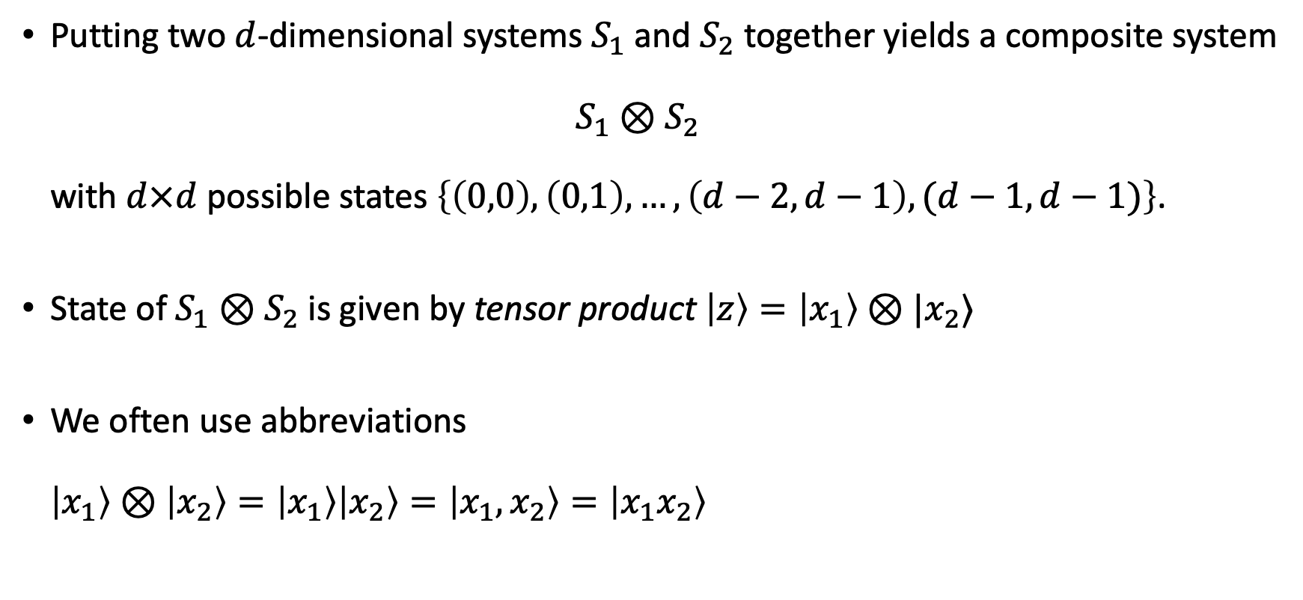



Composite systems
Putting two $d$-dimensional systems $S_{1}$ and $S_{2}$ together yields a composite system $S_{1}⊗S_{2}$ with $d×d$ possible states $\left\{\left(0,0\right),\left(0,1\right),…,\left(d−2,d−1\right),(d−1,d−1)\right\}$.
State of $S_{1}⊗S_{2}$ is given by tensor product $\left|z\right\rangle =\left|x_{1}\right\rangle ⊗|x_{2}⟩$
We often use abbreviations $\left|x_{1}\right\rangle ⊗\left|x_{2}\right\rangle =\left|x_{1}\right\rangle \left|x_{2}\right\rangle =\left|x_{1},x_{2}\right\rangle =\left|x_{1}x_{2}\right\rangle$
$$|x_{1}⟩$$
$$|x_{2}⟩$$
$$S_{1}$$
$$S_{2}$$

Slide 20









Composite systems
If $R_{1}$ acts on system $S_{1}$ and $R_{2}$ acts on $S_{2}$, then $R=R_{1}⊗R_{2}$ is a transformation on $S_{1}⊗S_{2}$.
$$R_{2}$$
$$R_{1}$$
$$|x_{1}⟩$$
$$R_{1}|x_{1}⟩$$
$$R_{2}|x_{2}⟩$$
$$|x_{2}⟩$$
$$S_{1}$$
$$S_{2}$$

Slide 21
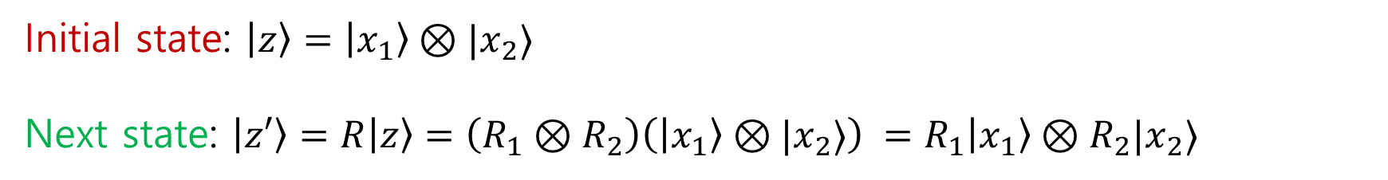


Composite systems
If $R_{1}$ acts on system $S_{1}$ and $R_{2}$ acts on $S_{2}$, then $R=R_{1}⊗R_{2}$ is a transformation on $S_{1}⊗S_{2}$.
Applying $R_{1}$ to $S_{1}$ and nothing to $S_{2}$ corresponds to the transformation $R_{1}⊗I$.
Initial state: $\left|z\right\rangle =\left|x_{1}\right\rangle ⊗|x_{2}⟩$
Next state: $\left|z′\right\rangle =R\left|z\right\rangle =\left(R_{1}⊗R_{2}\right)\left(\left|x_{1}\right\rangle ⊗|x_{2}⟩\right) =R_{1}\left|x_{1}\right\rangle ⊗R_{2}|x_{2}⟩$
$$R_{1}|x_{1}⟩$$
$$R_{2}|x_{2}⟩$$
$$S_{1}$$
$$S_{2}$$

Slide 22





Composite systems
There are transformations on $S_{1}⊗S_{2}$ that cannot be written as tensor product of separate transformations $R_{1}$ on $S_{1}$ and $R_{2}$ on $S_{2}$. Such transformations interact the systems $S_{1}$ and $S_{2}$ together.
Example:
$S_{1}$ and $S_{2}$ are bits, i.e., $d=2$, with states $\left|0\right\rangle ,|1⟩$
“Controlled-NOT” operation $CNOT$:
$$\left|0,0\right\rangle ↦\left|0,0\right\rangle$$
$$\left|0,1\right\rangle ↦\left|0,1\right\rangle$$
$$\left|1,0\right\rangle ↦\left|1,1\right\rangle$$
$$\left|1,1\right\rangle ↦\left|1,0\right\rangle$$
$$\left|a,b\right\rangle ↦\left|a,b⊕a\right\rangle$$
$$|x_{1}⟩$$
$$|x_{2}⟩$$
First bit ( “control bit”) controls if second bit (“target bit”) gets flipped.
$$S_{1}$$
$$S_{2}$$

Slide 23
Reversible computation circuits
We can put many bits together to compute:
Computation: a sequence of pre-determined reversible transformations on specified subsystems.

Slide 24




Reversible circuits
Reversible computation can be described using the circuit diagram.
Multi-bit gates
$$\left|x_{1}\right\rangle$$
$$\left|x_{2}\right\rangle$$
n bit input
$$\left|x_{3}\right\rangle$$
……
$$\left|x_{n}\right\rangle$$
1 bit gates
Time

Slide 25







Reversible circuits
CNOT gate
ctrl
tgt
Compute the final state of circuit:
NOT gate
$$\left|1\right\rangle$$
$$|a⟩$$
$$X$$
$$|a⊕1⟩$$
$$\left|0\right\rangle$$
$$X$$
$$\left|0\right\rangle$$

Slide 26
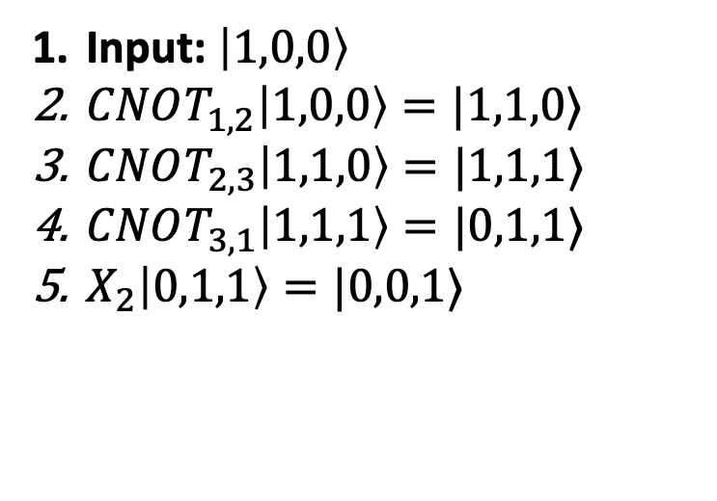
Reversible circuits
CNOT gate
ctrl
tgt
Compute the final state of circuit:
NOT gate
$$\left|1\right\rangle$$
$$|a⟩$$
$$X$$
$$|a⊕1⟩$$
$$\left|0\right\rangle$$
$$X$$
$$\left|0\right\rangle$$
Input: $\left|1,0,0\right\rangle$
$CNOT_{1,2}\left|1,0,0\right\rangle =|1,1,0⟩$
$CNOT_{2,3}\left|1,1,0\right\rangle =|1,1,1⟩$
$CNOT_{3,1}\left|1,1,1\right\rangle =|0,1,1⟩$
$X_{2}\left|0,1,1\right\rangle =|0,0,1⟩$
1
2
3
4
5

Slide 27





Reversible computing, linear algebra style
We rephrase reversible computing on a linear algebraic foundation
States of $d$-dim system $S$ are represented by $d$-dim column vectors
$$|0⟩=\left(\begin{matrix}1 \\ 0 \\ ⋮ \\ 0\end{matrix}\right)$$
$$|1⟩=\left(\begin{matrix}0 \\ 1 \\ ⋮ \\ 0\end{matrix}\right)$$
$$|d−1⟩=\left(\begin{matrix}0 \\ 0 \\ ⋮ \\ 1\end{matrix}\right)$$
$$⋯$$

Slide 28
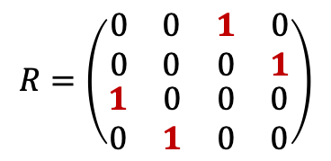


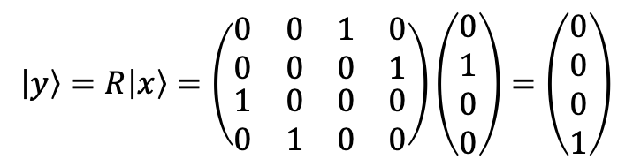
Transformation matrices
Reversible transformations correspond to $d×d$ permutation matrices.
Applying transformation $R$to $|x⟩$ corresponds to mat-vec multiplication.
Matrix with exactly one 1 in each column and row
$$R=\left(\begin{matrix}\begin{matrix}0 & 0 \\ 0 & 0\end{matrix} & \begin{matrix}1 & 0 \\ 0 & 1\end{matrix} \\ \begin{matrix}1 & 0 \\ 0 & 1\end{matrix} & \begin{matrix}0 & 0 \\ 0 & 0\end{matrix}\end{matrix}\right)$$
$\left|x\right\rangle =\left(\begin{matrix}0 \\ 1 \\ 0 \\ 0\end{matrix}\right)$,
$$\left|y\right\rangle =R\left|x\right\rangle =\left(\begin{matrix}\begin{matrix}0 & 0 \\ 0 & 0\end{matrix} & \begin{matrix}1 & 0 \\ 0 & 1\end{matrix} \\ \begin{matrix}1 & 0 \\ 0 & 1\end{matrix} & \begin{matrix}0 & 0 \\ 0 & 0\end{matrix}\end{matrix}\right)\left(\begin{matrix}0 \\ 1 \\ 0 \\ 0\end{matrix}\right)=\left(\begin{matrix}0 \\ 0 \\ 0 \\ 1\end{matrix}\right)$$

Slide 29
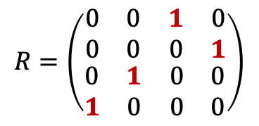
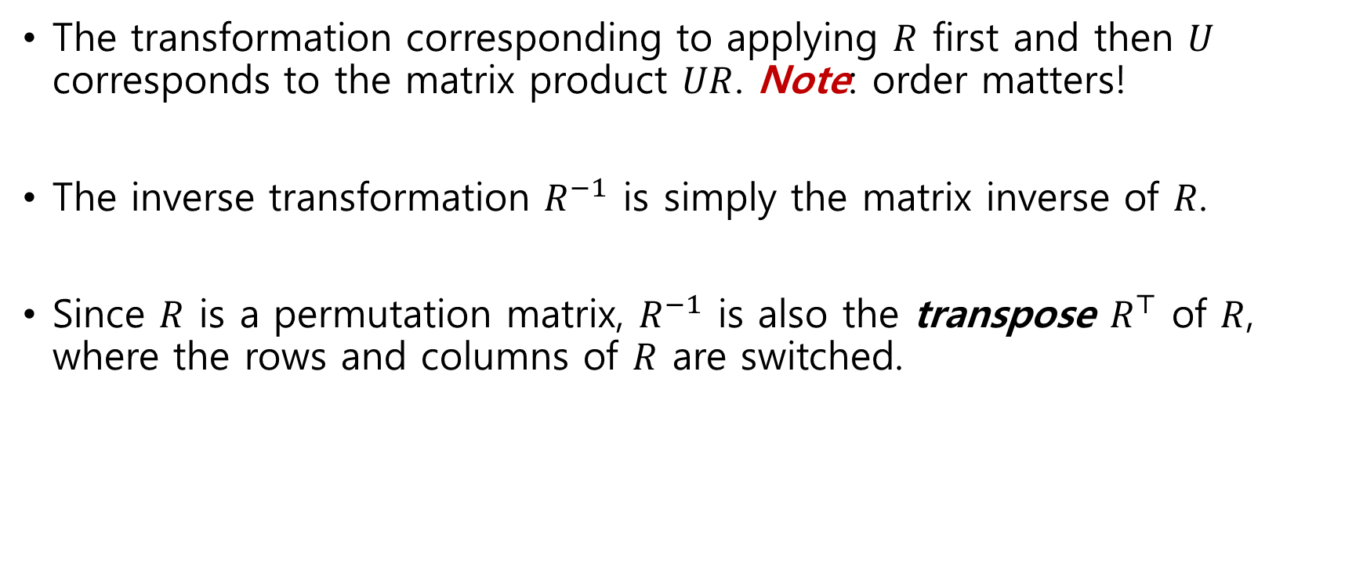

Transformation matrices
The transformation corresponding to applying $R$ first and then $U$ corresponds to the matrix product $UR$. Note: order matters!
The inverse transformation $R^{−1}$ is simply the matrix inverse of $R$.
Since $R$ is a permutation matrix, $R^{−1}$ is also the transpose $R^{⊤}$ of $R$, where the rows and columns of $R$ are switched.
$$R=\left(\begin{matrix}\begin{matrix}0 & 0 \\ 0 & 0\end{matrix} & \begin{matrix}1 & 0 \\ 0 & 1\end{matrix} \\ \begin{matrix}0 & 1 \\ 1 & 0\end{matrix} & \begin{matrix}0 & 0 \\ 0 & 0\end{matrix}\end{matrix}\right)$$
$$R^{⊤}=\left(\begin{matrix}\begin{matrix}0 & 0 \\ 0 & 0\end{matrix} & \begin{matrix}0 & 1 \\ 1 & 0\end{matrix} \\ \begin{matrix}1 & 0 \\ 0 & 1\end{matrix} & \begin{matrix}0 & 0 \\ 0 & 0\end{matrix}\end{matrix}\right)$$

Slide 30
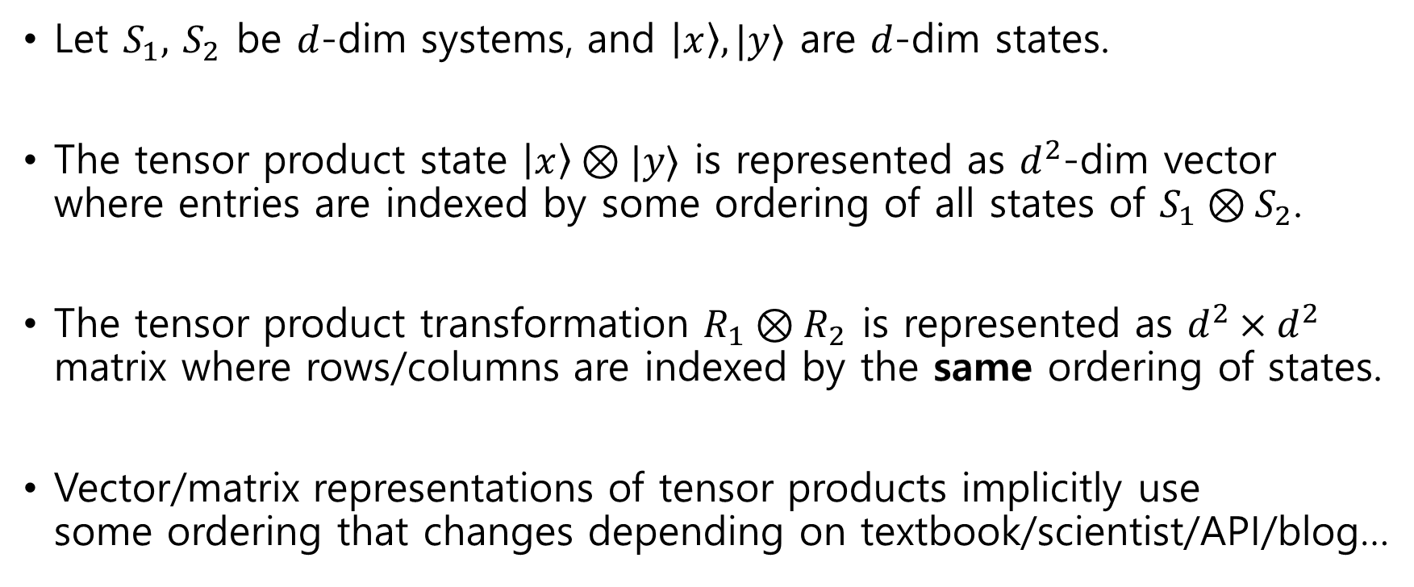
Tensor products in linear algebra
Let $S_{1},$ $S_{2}$ be $d$-dim systems, and $\left|x\right\rangle ,|y⟩$ are $d$-dim states.
The tensor product state $\left|x\right\rangle ⊗|y⟩$ is represented as $d^{2}$-dim vector where entries are indexed by some ordering of all states of $S_{1}⊗S_{2}$.
The tensor product transformation $R_{1}⊗R_{2}$ is represented as $d^{2}×d^{2}$ matrix where rows/columns are indexed by the same ordering of states.
Vector/matrix representations of tensor products implicitly use some ordering that changes depending on textbook/scientist/API/blog…

Slide 31
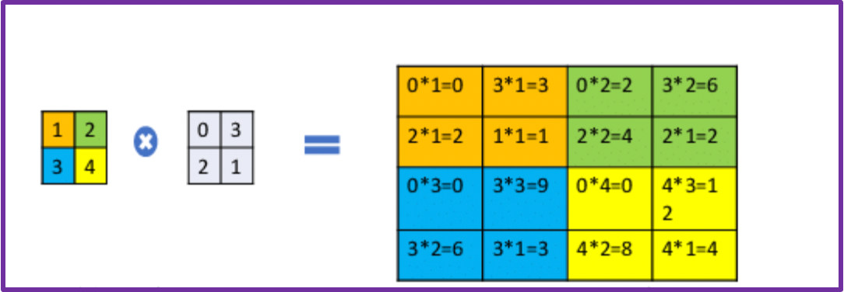
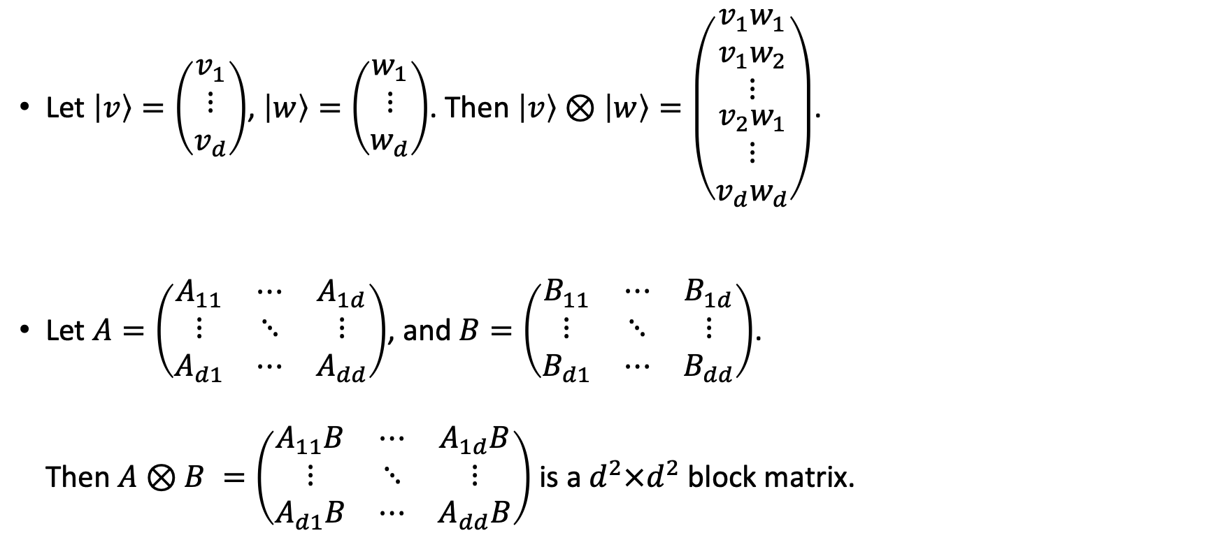
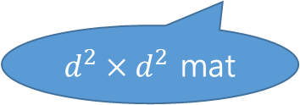

Tensor products, representations
Let $\left|v\right\rangle =\left(\begin{matrix}v_{1} \\ ⋮ \\ v_{d}\end{matrix}\right)$, $\left|w\right\rangle =\left(\begin{matrix}w_{1} \\ ⋮ \\ w_{d}\end{matrix}\right)$. Then $\left|v\right\rangle ⊗\left|w\right\rangle =\left(\begin{matrix}\begin{aligned}{v_{1}w}_{1} \\ v_{1}w_{2}\end{aligned} \\ ⋮ \\ \begin{aligned}v_{2}w_{1} \\ ⋮ \\ v_{d}w_{d}\end{aligned}\end{matrix}\right)$.
Let $A=\left(\begin{matrix}A_{11} & ⋯ & A_{1d} \\ ⋮ & ⋱ & ⋮ \\ A_{d1} & ⋯ & A_{dd}\end{matrix}\right)$, and $B=\left(\begin{matrix}B_{11} & ⋯ & B_{1d} \\ ⋮ & ⋱ & ⋮ \\ B_{d1} & ⋯ & B_{dd}\end{matrix}\right)$. Then $A⊗B =\left(\begin{matrix}A_{11}B & ⋯ & A_{1d}B \\ ⋮ & ⋱ & ⋮ \\ A_{d1}B & ⋯ & A_{dd}B\end{matrix}\right)$ is a $d^{2}×d^{2}$block matrix.
$d^{2}$ dim
$d^{2}×d^{2}$ mat

Slide 32
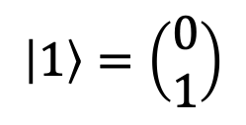
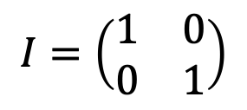
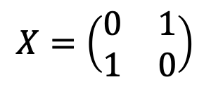
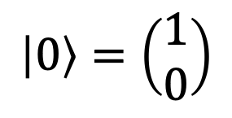
Tensor products, bits
$S$ is a bit, i.e., $d=2$. Vector representation of states:
$$\left|0\right\rangle =\left(\begin{aligned}1 \\ 0\end{aligned}\right)$$
$$\left|1\right\rangle =\left(\begin{aligned}0 \\ 1\end{aligned}\right)$$
Transformations:
$$I=\left(\begin{matrix}1 & 0 \\ 0 & 1\end{matrix}\right)$$
$$X=\left(\begin{matrix}0 & 1 \\ 1 & 0\end{matrix}\right)$$

Slide 33
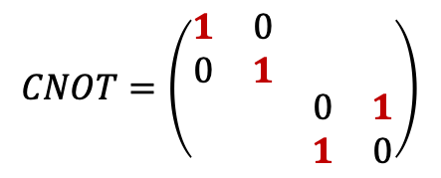
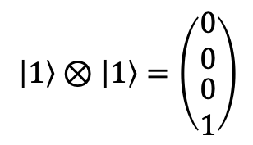
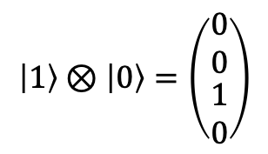
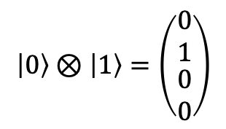
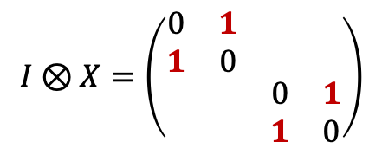
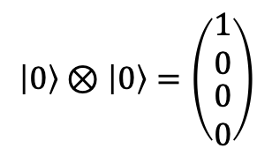
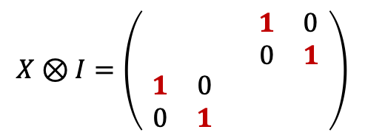
Tensor products, bits
Vector representation of two bits:
$$\left|0\right\rangle ⊗\left|0\right\rangle =\left(\begin{matrix}1 \\ 0 \\ \begin{aligned}0 \\ 0\end{aligned}\end{matrix}\right)$$
$$\left|0\right\rangle ⊗\left|1\right\rangle =\left(\begin{matrix}0 \\ 1 \\ \begin{aligned}0 \\ 0\end{aligned}\end{matrix}\right)$$
$$\left|1\right\rangle ⊗\left|0\right\rangle =\left(\begin{matrix}0 \\ 0 \\ \begin{aligned}1 \\ 0\end{aligned}\end{matrix}\right)$$
$$\left|1\right\rangle ⊗\left|1\right\rangle =\left(\begin{matrix}0 \\ 0 \\ \begin{aligned}0 \\ 1\end{aligned}\end{matrix}\right)$$
Matrix representation of transformations:
$$I⊗X=\left(\begin{matrix}\begin{matrix}0 & 1 \\ 1 & 0\end{matrix} & \\ & \begin{matrix}0 & 1 \\ 1 & 0\end{matrix}\end{matrix}\right)$$
$$X⊗I=\left(\begin{matrix}\begin{matrix} & \\ & \end{matrix} & \begin{matrix}1 & 0 \\ 0 & 1\end{matrix} \\ \begin{matrix}1 & 0 \\ 0 & 1\end{matrix} & \begin{matrix} & \\ & \end{matrix}\end{matrix}\right)$$
$$CNOT=\left(\begin{matrix}\begin{matrix}1 & 0 \\ 0 & 1\end{matrix} & \\ & \begin{matrix}0 & 1 \\ 1 & 0\end{matrix}\end{matrix}\right)$$

Slide 34







Reversible circuits as matrix products
Compute the final state of circuit:
CNOT gate
NOT gate
$$\left|1\right\rangle$$
ctrl
$$|a⟩$$
$$X$$
$$|a⊕1⟩$$
$$\left|0\right\rangle$$
$$X$$
tgt
$$\left|0\right\rangle$$
Input: $\left|1,0,0\right\rangle$
$CNOT_{1,2}\left|1,0,0\right\rangle =|1,1,0⟩$
$CNOT_{2,3}\left|1,1,0\right\rangle =|1,1,1⟩$
$CNOT_{3,1}\left|1,1,1\right\rangle =|0,1,1⟩$
$X_{2}\left|0,1,1\right\rangle =|0,0,1⟩$
1
2
3
4
5
$$\left|1\right\rangle ⊗\left|0\right\rangle ⊗\left|0\right\rangle$$
$$I⊗CNOT$$
$$I⊗X⊗I$$
$$CNOT⊗I$$
(…hard to write down)
$$X_{2}⋅CNOT_{3,1}⋅CNOT_{2,3}⋅CNOT_{1,2}\left(\left|1\right\rangle ⊗\left|0\right\rangle ⊗\left|0\right\rangle \right)$$

Slide 35


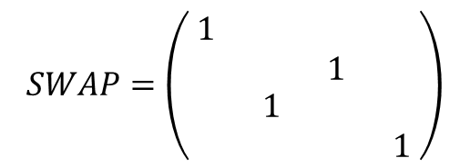
If you really want to formally write down…
$$\left|0\right\rangle ⊗\left|0\right\rangle =\left(\begin{matrix}1 \\ 0 \\ \begin{aligned}0 \\ 0\end{aligned}\end{matrix}\right)$$
$$\left|0\right\rangle ⊗\left|1\right\rangle =\left(\begin{matrix}0 \\ 1 \\ \begin{aligned}0 \\ 0\end{aligned}\end{matrix}\right)$$
$$\left|1\right\rangle ⊗\left|0\right\rangle =\left(\begin{matrix}0 \\ 0 \\ \begin{aligned}1 \\ 0\end{aligned}\end{matrix}\right)$$
$$\left|1\right\rangle ⊗\left|1\right\rangle =\left(\begin{matrix}0 \\ 0 \\ \begin{aligned}0 \\ 1\end{aligned}\end{matrix}\right)$$
$$\left|1\right\rangle$$
SWAP gate
$$SWAP=\left(\begin{matrix}\begin{matrix}1 & \\ & \end{matrix} & \begin{matrix} & \\ 1 & \end{matrix} \\ \begin{matrix} & 1 \\ & \end{matrix} & \begin{matrix} & \\ & 1\end{matrix}\end{matrix}\right)$$
$$\left|0\right\rangle$$
$$X$$
a
b
b
a
$$\left|0\right\rangle$$
1
2
3
4
5
$$\left|1\right\rangle ⊗\left|0\right\rangle ⊗\left|0\right\rangle$$
$$I⊗CNOT$$
$$I⊗X⊗I$$
$$\left(SWAP⊗I\right)⋅\left(I⊗SWAP\right)⋅\left(I⊗CNOT\right)⋅\left(I⊗SWAP\right)⋅(SWAP⊗I)$$
$$CNOT⊗I$$
$$=$$

Slide 36
Summary of composite systems
Composite systems = tensor product of systems
Transformations on composite systems are
Tensor product of transformations on each system
Mixing systems (CNOT, SWAP, …)
Or compositions of them
Circuit framework (Often convenient)
Linear algebraic framework (Based on math we know)

Slide 37




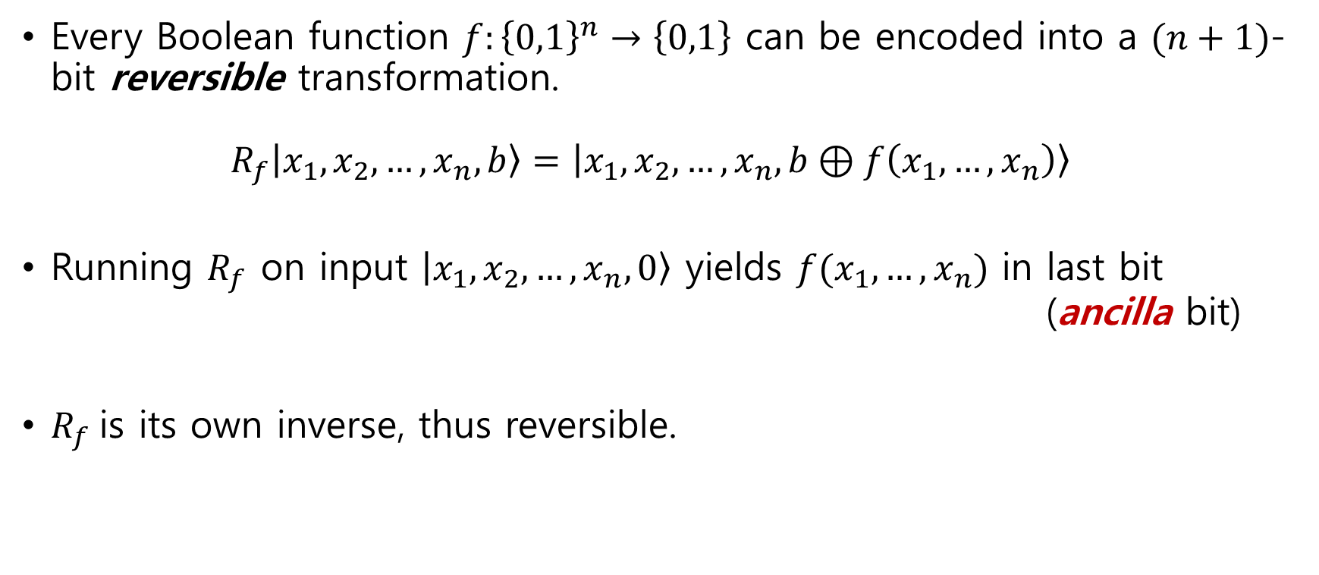





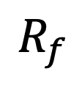

Universal computation with reversible circuits
Slightly advanced
Every Boolean function $f:{\left\{0,1\right\}}^{n}→\left\{0,1\right\}$ can be encoded into a $(n+1)$-bit reversible transformation. $R_{f}\left|x_{1},x_{2},…,x_{n},b\right\rangle =\left|x_{1},x_{2},…,x_{n},b⊕f\left(x_{1},…, x_{n}\right)\right\rangle$
Running $R_{f}$ on input $\left|x_{1},x_{2},…,x_{n},0\right\rangle$ yields $f(x_{1},…,x_{n})$ in last bit (ancilla bit)
$R_{f}$is its own inverse, thus reversible.
$$\left|x_{1}\right\rangle$$
$$\left|x_{1}\right\rangle$$
$$\left|x_{2}\right\rangle$$
$$\left|x_{2}\right\rangle$$
$$\left|x_{3}\right\rangle$$
$$R_{f}$$
$$\left|x_{3}\right\rangle$$
…
…
…
$$\left|x_{n}\right\rangle$$
$$\left|x_{n}\right\rangle$$
$$\left|b\right\rangle$$
$$\left|b⊕f(x)\right\rangle$$

Slide 38














Irreversible circuits to reversible circuits
Slightly advanced
An irreversible circuit $C_{f}$for $f$, consisting of AND/OR/NOT gates, can be used to construct a reversible circuit for $R_{f}$.
High level idea: convert each gate of $C_{f}$ into its reversible equivalent.
In general, this construction requires many ancilla bits.
$$C_{f}$$
$$R_{f}$$
$$\left|x_{1}\right\rangle$$
$$\left|x_{1}\right\rangle$$
$$\left|x_{2}\right\rangle$$
$$\left|x_{2}\right\rangle$$
$$\left|x_{3}\right\rangle$$
$$\left|x_{3}\right\rangle$$
…
…
…
$$\left|x_{n}\right\rangle$$
$$\left|x_{n}\right\rangle$$
$$\left|b\right\rangle$$
$$\left|b⊕f(x)\right\rangle$$

Slide 39




Universal gate set for reversible computing
Slightly advanced
Every Boolean function $f:{\left\{0,1\right\}}^{n}→\left\{0,1\right\}$ can be represented by a Boolean polynomial
NOT + CNOT + CCNOT forms a universal gate set (with ancillas) because they can form any Boolean polynomial gate
NOT gate
CNOT gate
CCNOT gate
$$|a⟩$$
$$X$$
$$|a⊕1⟩$$
ctrl
ctrl
tgt
ctrl
tgt

Slide 40
Summary of reversible computing
Landauer: reversibility of physics implies reversibility of computation
Principles of reversible computing
Universal computing with reversible circuits
Linear algebra formulation of reversible computing
Next: quantum information!

Slide 41




Basic complexity theory, btw
$|x|$ denotes the length of x
${\left\{0,1\right\}}^{∗}$ denotes the set of all binary strings
The basic problems, language, are decisional problems: YES/No questions given binary descriptions
Equivalently, the language $L$ asks, given problem instance $x$:
To compute $f_{|x|}(x)$ for Boolean functions ${\left(f_{n}:{\left\{0,1\right\}}^{n}→\{0,1\}\right)}_{n∈ℕ}$ for each n
To compute $f(x)$ for a Boolean function $f:{\left\{0,1\right\}}^{∗}→\{0,1\}$
To check if $x∈L_{yes}$ for a set $L_{yes}⊂{\left\{0,1\right\}}^{∗}$
We say a language $L$ is in P if there is an algorithm (aka Turing machine) $M$ such that:
For all x, $M\left(x\right)=L(x)$
For all x, $M\left(x\right)$ runs in time $p(\left|x\right|)$ for a fixed polynomial $p$
We define $L:=f$ in this case
We say M a polynomial time algorithm

Slide 42

Circuit-style definitions (proving equivalence is )
Slightly advanced
advanced
We say a language $L$ is in P if there is a polynomial-time algorithm $M$ such that:
For all x, $M\left(x\right)$ outputs a polynomial-size (binary-output) circuit $C_{|x|}$ such that $C_{|x|}\left(x\right)=L(x)$
Here we enforces that the circuit is generated in polynomial time!
We say a language $L$ is in RevP if there is a polynomial-time algorithm $M$ such that:
For all x, $M\left(x\right)$ outputs a polynomial-size reversible circuit $C_{|x|}$ such that (the last bit of $C_{\left|x\right|}\left(x\right)$) $=L(x)$
The formal statement of “universal computation with reversible circuits”:
[Theorem] There is a polynomial time algorithm that takes a (binary-output) circuit $C$ as input and outputs a reversible circuit $C′$ such that $C\left(x\right)=\text{(}\text{the} \text{last} \text{bit} \text{of} C′\left(x\right)\text{)}$ for all x
[Corollary] RevP=P
This will be convenient

Slide 43

Other complexity notions
We say a language $L$ is in P/poly if there is a family of circuits ${\left\{C_{n}\right\}}_{n∈ℕ}$ such that:
The size of $C_{n}$ grows polynomially in $n$ (i.e. C is polynomial-size circuits)
$C_{\left|x\right|}\left(x\right)=L(x)$
We say a language $L$ is in NP if there is a polynomial-time algorithm $M$ such that:
For all $x∈L$, there is y such that $M\left(x,y\right)→1$
For all $x∉L$, $M\left(x,y\right)→0$ for all $y$
Most standard approaches to show P$≠$NP actually try to show NP$⊈$P/poly
We only know NP$⊈$Size[3.1n] (ignoring smaller terms)
(2n in 1960s, 2.5n in 1977, 3n in 1984, 3.01n in 2016, 3.1n in 2022)
If it grows like f(n), the class is called Size[f]
TOO MUCH advanced

Slide 44

Recommended textbook

